Slide 1


IDIOMATIC EXPRESSIONS

Slide 2
What do IDIOMS mean?
🞇 Idioms are fun useful expressions that usually can’t be understood by defining the separate words.
🞇 Idioms need to be memorize as a whole.

Slide 3
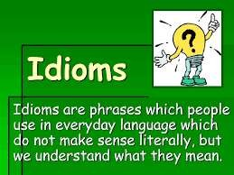

Slide 4
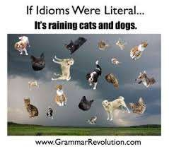

Slide 5
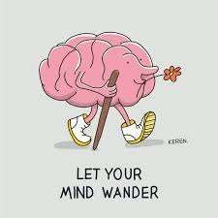
IF IDIOMS ARE LITERAL..

Slide 6
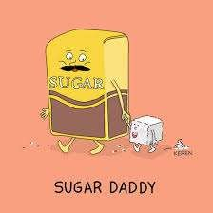
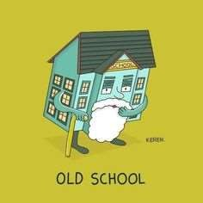
IF IDIOMS ARE LITERAL..

Slide 7
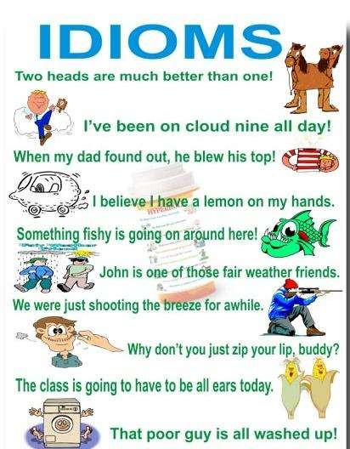

Slide 8
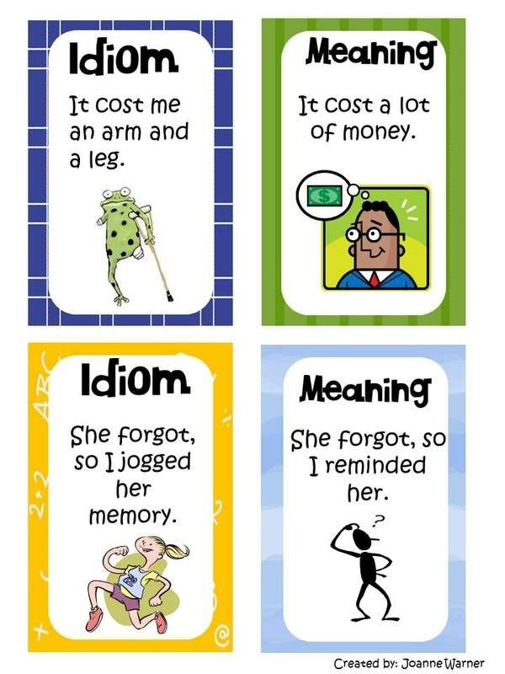
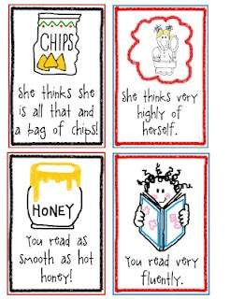

Slide 9
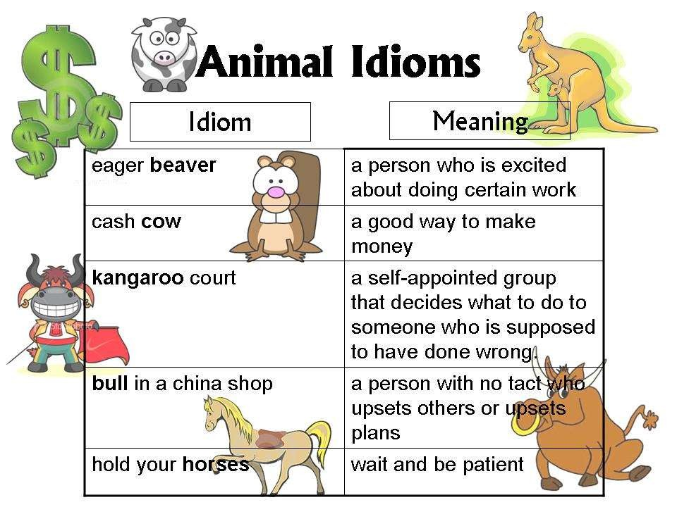

Slide 10
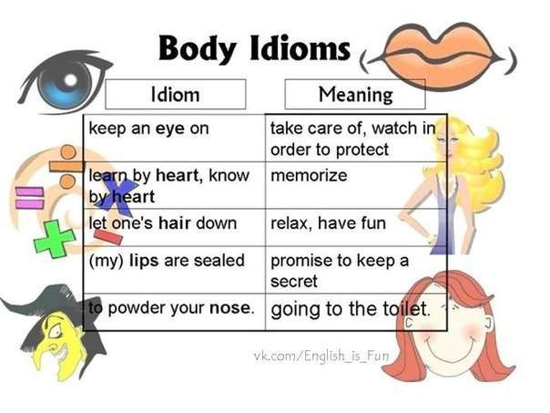

Slide 11
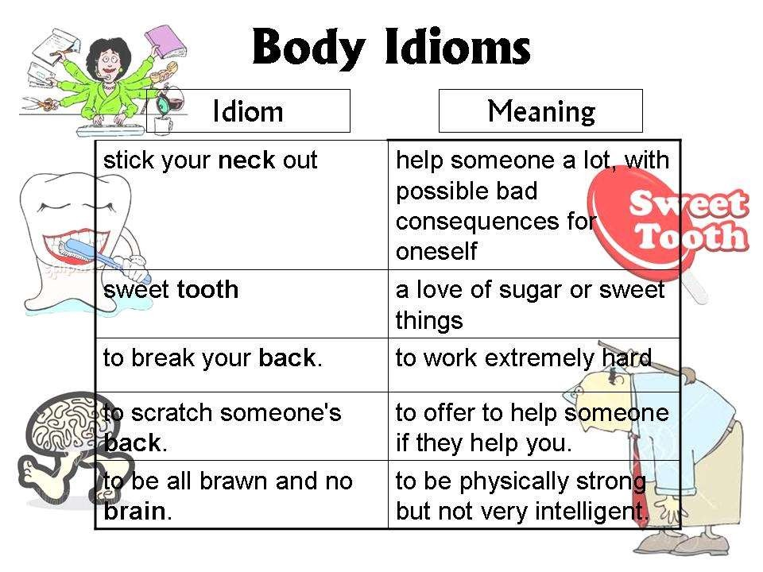

Slide 12
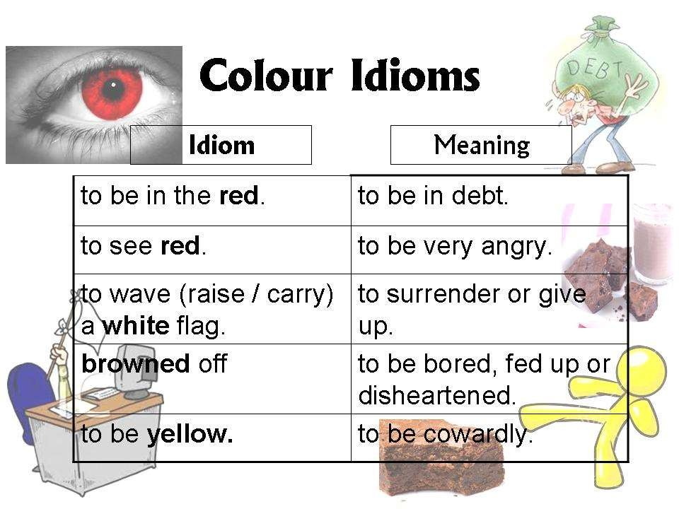

Slide 13
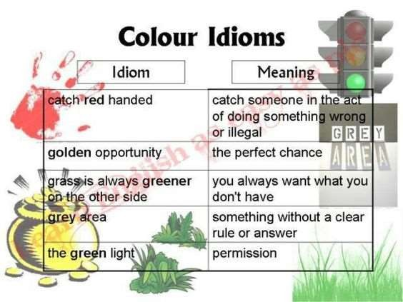

Slide 14
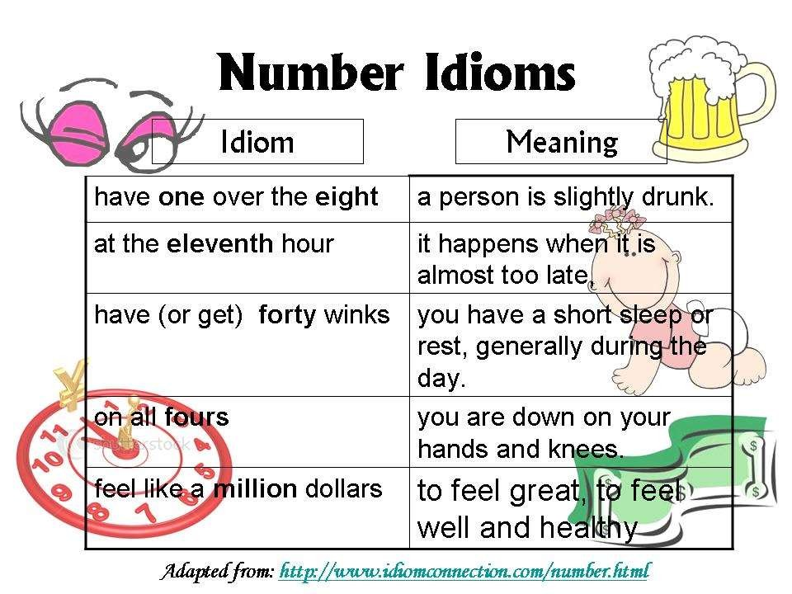

Slide 15
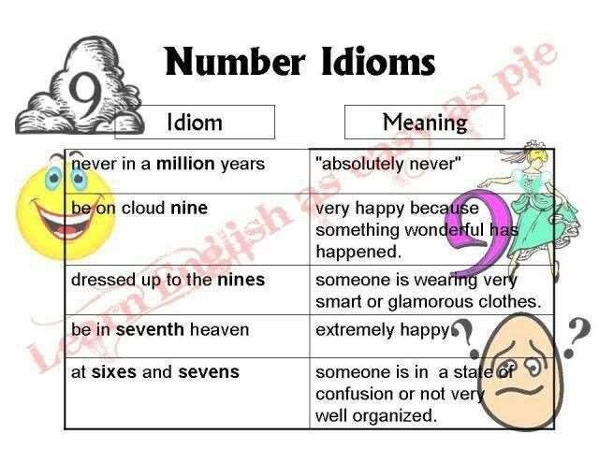

Slide 16
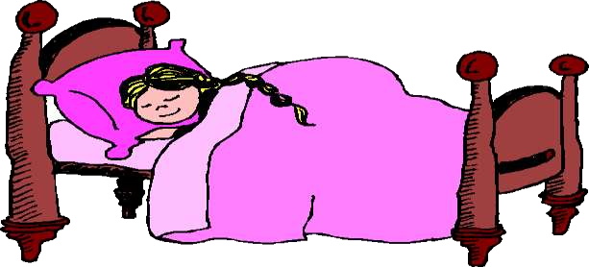
Example :
If your mother says, I think it’s time to hit the hay’ , she means it’s Bedtime !

Slide 17
The Origin of IDIOMS
🞇 Most idioms come from ancient literature or even classic films.
🞇 Many idioms originated as quotations from well-known writers such as Shakespear.
🞇 Learning the background of idioms can help you to remember them.

Slide 18
🞇 IDIOMS should be use in proper situations, they enrich our speech and increase our vocabulary.
🞇 The grammar and the vocabulary of IDIOMS are fixed, and if we change them, we lose the meaning of the Idiom.

Slide 19
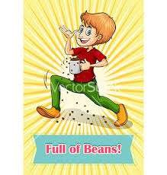
ENGLISH IDIOMS
Full of beans = have a lot of energy
the boy has full of beans in the office

Slide 20
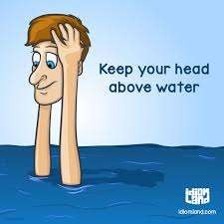
🞇 Keep one’s head above water = have just
enough money to live.
🞇 It’s hard to keep My head above Water with all of These medical bills.

Slide 21
English idioms
🞇 down to earth = natural or real
🞇 Out of woods = Clear of danger
🞇 Wear the trousers = be in-charge , make the rules
🞇 Break a leg ! = good luck (performer)
🞇 Have the blues = be depressed or sad

Slide 22
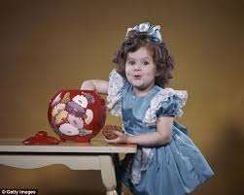
Catch red handed = catch someone in the act doing something wrong or illegal
Example:
The girl was caught Red handed stealing
the biscuits.

Slide 23
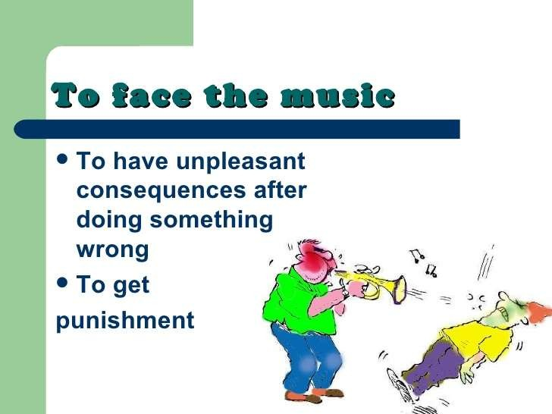

Slide 24
Quiz time!!!! ☺

Slide 25
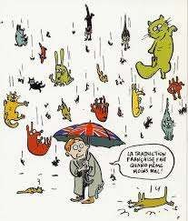
Check how you understand English Idioms
It’s raining cats and dogs! So,
Take an umbrella
Keep your pets aside
Watch out for falling animal

Slide 26
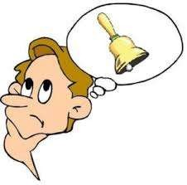
2. When I heard the poem, some of the lines
rang a bell and
Sounded very beautiful
It thought I heard it somewhere before
Some of them beat a drum

Slide 27
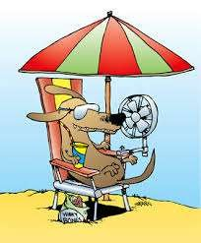
3. During the dog days in summer
I have some problems with my boss
I wear light clothes because its very hot
People are allowed to come to beach with their dogs.

Slide 28
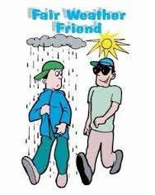
4. Joe is only a fair-weather friend. That’s why,
We got out only when the weather is fine
She is the person who I can trust
I can rely on her in difficult situations

Slide 29
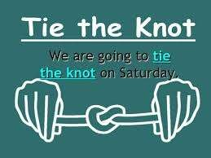
5. Mike and Kate decided to tie the knot
because
It had become undone
They love each other
They needed to save money

Slide 30
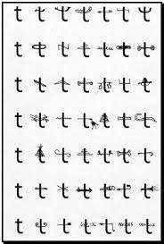
6. I’ve dotted the i’s and crossed the t’s , so there,
shouldn’t be any mistakes
Will be a few mistakes
Will be lots of mistakes

Slide 31

7. If you address to a big cheese you should
Speak to him as if he is a VIP
Ask him what sort of cheese he likes
Advice the person to do the sport in order to lose weight

Slide 32
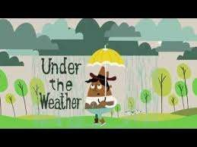
8. I was feeling under the weather so,
I took my umbrella with me
Next time I should listen to the weather forecast
I went back to bed, cause I’m not feeling well

Slide 33
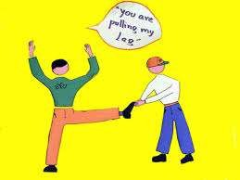
9. If someone is pulling my leg, it means:
he’s massaging it
We are doing gymnastics
He’s joking

Slide 34
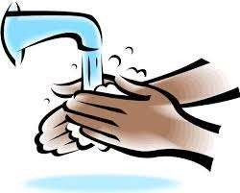
Pontious Pilate Wash his hands of.
Because its dirty
He Stops being responsible in the situation/problem
Before and after meals

Slide 35
Matching type :
1. Mad as Hornet
to be very quite
a natural ability
keeping your source of information
to have some unhappy with you
2. Eat like a pig
3.A little bird told me
4. Eagles eyes
5. Like a duck to water e. to eat a lot
6. In the dog house
to see better that average
very angry
A situation that irritates someone
Bought by many
Succeed without difficulty
7. Pet peeve
8. Quite as a mouse
9. Sail through it
10. Sell like hot cakes

Slide 36
Answer keys
test 1:
A
B
B
C
B
A
A
C
C
B

Slide 37
Test 2:
G
E
C
F
B
D
H
A
J
I

